Slide 1
R Review
Please open A_Basic_Test_Drive.R

Slide 2


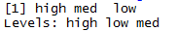
As you just saw R has many data types.
Numeric/Integer
Factors (Distinct Classes)
as.factor(c('MALE','FEMALE','FEMALE'))
1
10
12
3.47
82
MALE
FEMALE
FEMALE
Unordered
Cardinality
2
c(1,10,12,3.47)
[1] MALE FEMALE FEMALE
Levels: FEMALE MALE
High
Med
Low
Ordinal
as.factor(c(‘High',‘Med',‘Low'))
Cardinality
3
Boolean
STRING (just text)
c('MALE','FEMALE','FEMALE')
TRUE
TRUE
FALSE
TRUE
FALSE
c(T, T, F, T, F)
c(TRUE,TRUE, FALSE, TRUE,FALSE)
c(T,TRUE, F, TRUE,FALSE)
[1] "MALE" "FEMALE" "FEMALE"
In R, a vector can be numeric, Boolean (T/F), factors, or contain strings.

Slide 3
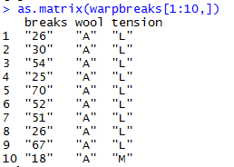
More Complex Common R Object Types - Matrix
Matrices are 2 dimensional data (rows/columns). Each column must be the same type.
RowID | breaks | wool | tension
1 | 26 | A | L
2 | 30 | A | L
3 | 54 | A | L
4 | 25 | A | L
5 | 70 | A | L
6 | 52 | A | L
7 | 51 | A | L
8 | 26 | A | L
9 | 67 | A | L
10 | 18 | A | M
All strings
Matrices are organized into rows & columns. Row names are not actually a vector of the matrix but are an attribute of the matrix. In excel you would need a standalone vector to capture that information.

Slide 4
More Complex Common R Object Types – List
Lists are multi-dimensional objects that can contain different data types of different lengths.
ListA
single value
Single data frame or matrix
single vector
Nested list
Nested data frame
Nested matrix
Lists are useful for data organization but can be complex and difficult to navigate to get specific information.

Slide 5
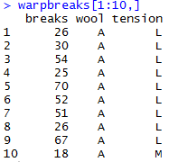
More Complex Common R Object Types – Data Frame
Data Frames are like 2 dimensional data objects but can have mixed data types.
A data frame is actually a named list but with equal length elements. Being a list lets it contain mixed data types.
RowID | breaks | wool | tension
1 | 26 | A | L
2 | 30 | A | L
3 | 54 | A | L
4 | 25 | A | L
5 | 70 | A | L
6 | 52 | A | L
7 | 51 | A | L
8 | 26 | A | L
9 | 67 | A | L
10 | 18 | A | M
Integers
Factor
Factor
Unlike a matrix, DFs can hold different types of vectors

Slide 6
When should you use a specific data type?
Number of Dimensions >1
No
Yes
Use a Vector
Data Types >1
No
Yes
Matrix or Array
Data Frame or List
Most analyses start with a data frame, and change classes as needed.

Slide 7
Open B_more basic R objects.R

Slide 8
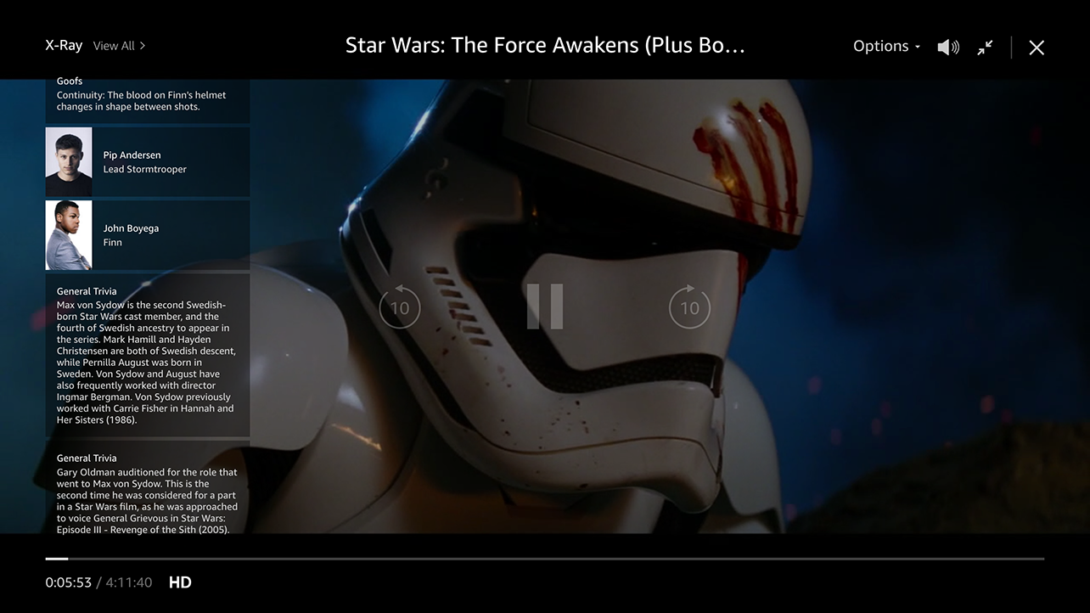
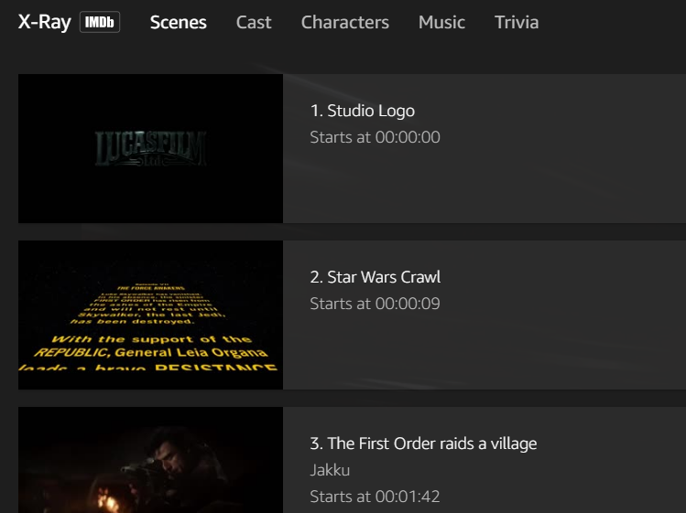
Amazon X-Ray: Movie Meta Data
Left Hand Screen:
Actor Information & Trivia
Center “Pop-over” Screen:
Scenes, Cast, Characters, Music & Trivia

Slide 9
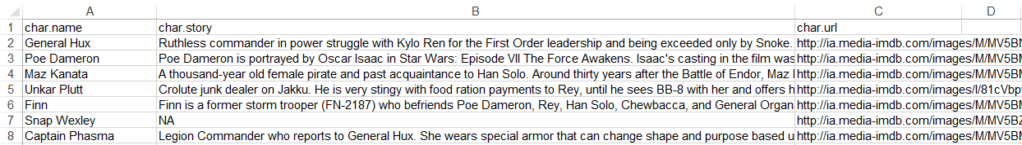
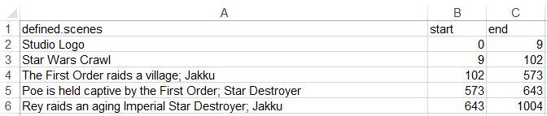
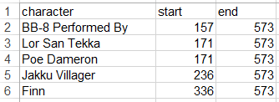
Let’s explore Amazon’s x-ray feature
Character Background
Official Scenes
Character Appearances

Slide 10



Let’s practice! Open C_Amazon_Xray.R
Learning Outcome: Following a consistent workflow, load, clean, & analyze real data with multiple data types to establish basic familiarity.
Your choice!

Slide 11
Do or Do Not There is No Try…

Slide 12

ggplot2 is the grammar of graphics
ggplot(scenesDF, aes(colour=scenesDF$name))
Layers are declared and added in sequence to construct a visual.

Slide 13
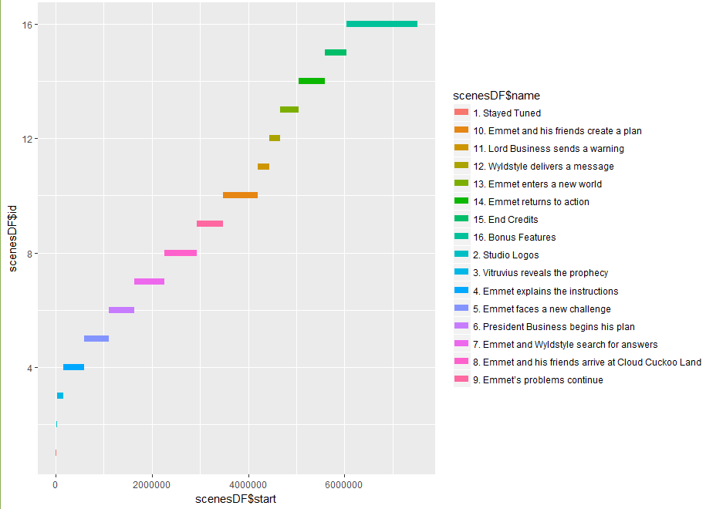
ggplot2: adding a layer
ggplot(scenesDF, aes(colour=scenesDF$name)) +
geom_segment(aes(x=scenesDF$start, xend=scenesDF$end,
y=scenesDF$id, yend=scenesDF$id),size=3)

Slide 14
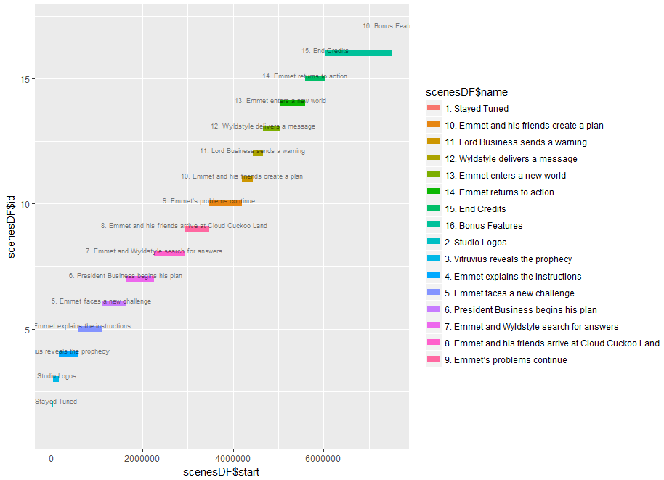
ggplot2: adding a layer of text
ggplot(scenesDF, aes(colour=scenesDF$name)) +
geom_segment(aes(x=scenesDF$start,xend=scenesDF$end,y=scenesDF$id,yend=scenesDF$id),size=3) +
geom_text(data=scenesDF, aes(x=scenesDF$end, y=scenesDF$id, label = scenesDF$name),
size = 2.25, nudge_y = 1.15,color = 'black', alpha = 0.5)

Slide 15
gpplot2: Adding an aesthetics layer
ggplot(scenesDF, aes(colour=scenesDF$name)) +
geom_segment(aes(x=scenesDF$start,xend=scenesDF$end,y=scenesDF$id,yend=scenesDF$id),size=3) +
geom_text(data=scenesDF, aes(x=scenesDF$end, y=scenesDF$id, label = scenesDF$name),
size = 2.25, nudge_y = 1.15,color = 'black', alpha = 0.5) +
theme_gdocs() + theme(legend.position="none")

Slide 16
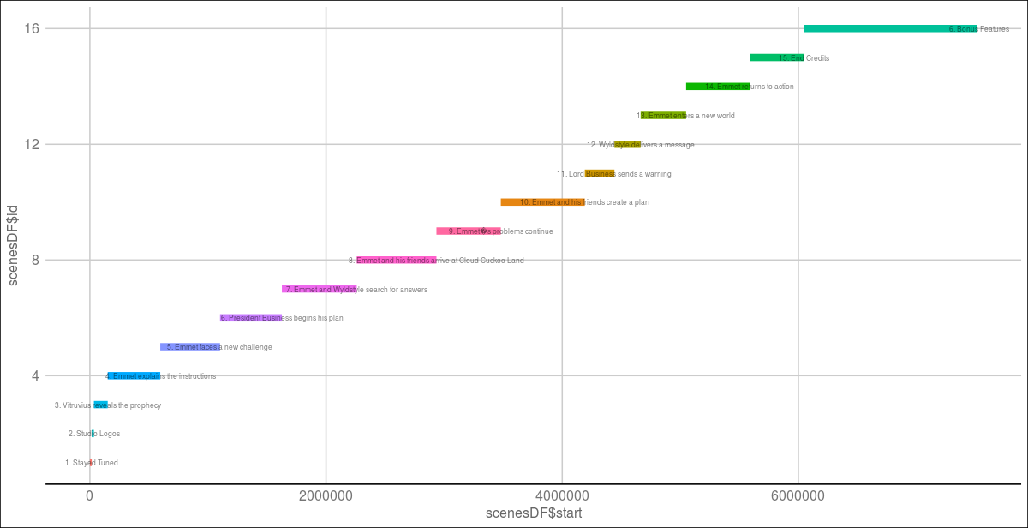

Slide 17



Let’s Practice…Open D_Amazon_Xray.R
Learning Outcome: change movies, examine and make another plot with less guidance.

Slide 18
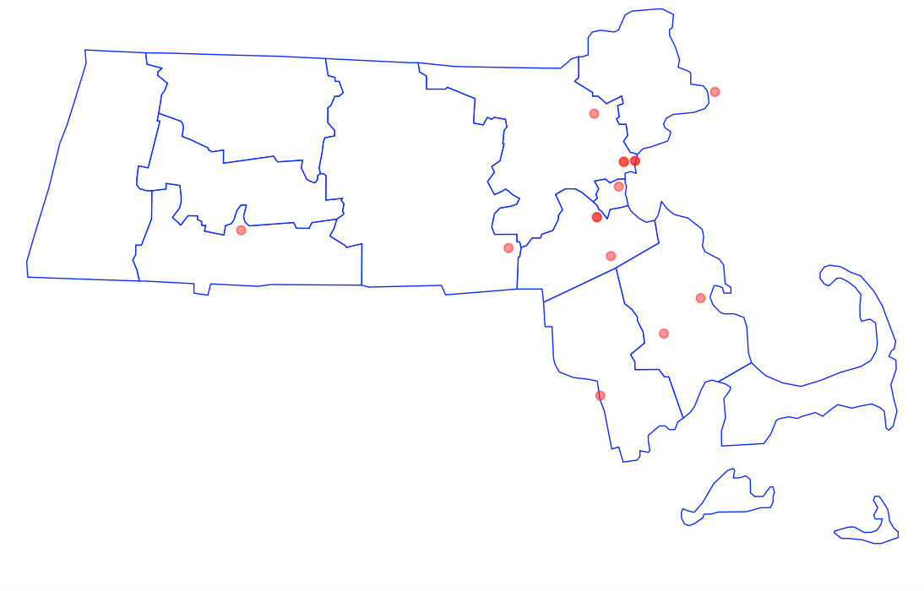
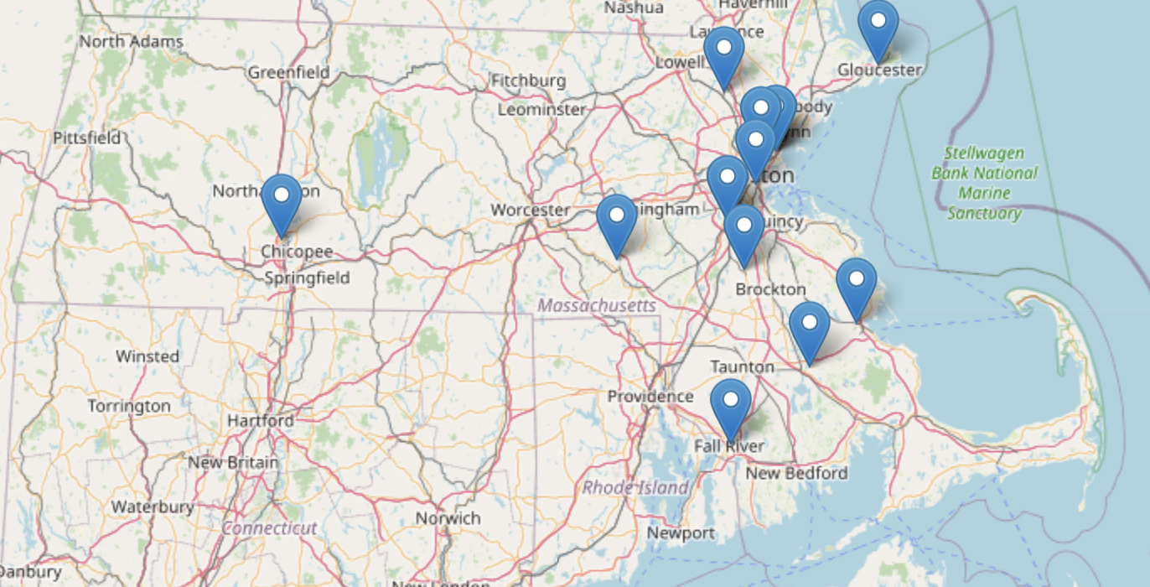
R can make maps
Static using base or GGPLOT graphics
As a dynamic webpage using leaflet
A chapter in the book uses named entity recognition (covered later in the week) and plots the locations on a map. We may have time for it but this quick detour demonstrates R robust & varied capabilities.

Slide 19
Let’s try out some mapping.
D_mapping_inR.R
Sometimes it is interesting to intersect geospatial with other analysis. For example, sentiment by country.

Slide 20


